Slide 1

Quasi-Periodic WaveNet: An Autoregressive Raw Waveform Generative Model with Pitch-dependent Dilated Convolution Neural Network
Monday, January 13th 2020
Yi-Chiao Wu
Toda Lab, Nagoya University

Slide 2

About me https://bigpon.github.io/
Education
Nagoya University, informatics (current)
Topics: voice conversion, speech synthesis
National Chiao Tung University, communication engineering (MS, BS)
Topic: speaker verification
Work experience
Academia Sinica, research assistant [2015–2017]
Topic: voice conversion, speech enhancement
Asus, software R&D [2013-2015]
Topic: speaker verification
Realtek, system designer [2012-2013]

Slide 3
Outline
Introduction
WaveNet
Quasi-Periodic WaveNet (QPNet)
Experiments
Conclusion

Slide 4
Characteristics of speech signal
Very high temporal resolution
Sampling rate (f_{s}) of telephone speech: 8 kHz
f_{s} of audio CDs: 44.1 kHz (human audible freq. <=20 kHz)
Very long-term dependency
More than 8000 sample points in one sec.
About 3 Chinese characters / English words in one sec.
Directly modeling speech waveform is challenging

Slide 5
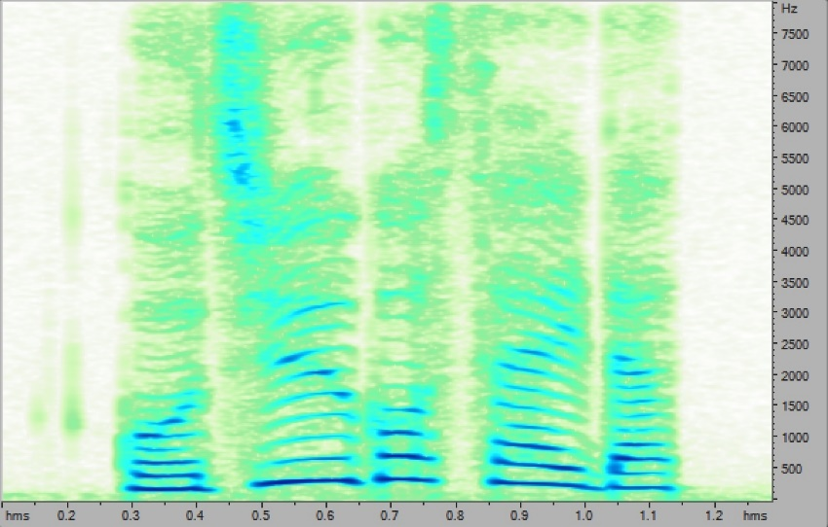
Quasi-periodic signal
Voiced speech (濁音)
Vocal cords (聲帶) vibrate
Fundamental frequency (F₀) and harmonics
Periodic signal
Vowel(母音), voiced consonant(有聲子音)
Unvoiced speech (清音):
Vocal cords no vibration
Non-periodic signal
Unvoiced consonant(無聲子音)

Slide 6
Conventional speech synthesis
Vocoder: voice coder
Encoder (analyzer)
decomposing speech into acoustic features
Decoder (synthesizer)
synthesizing speech from acoustic features

Slide 7
Speech model
Source-filter model [R. McAulay+, 1986]
Mixed excitation
Voiced excitation: “periodic pulse train (based on F₀)” mixed with “white noise”
Aperiodicity: the ratio of pulse train and white noise
Unvoiced excitation: “white noise”

Slide 8
Mixed excitation vocoder
STRAIGHT [H. Kawahara+, 1999]& WORLD [M. Morise+, 2016]
Encode speech into
Spectral feature: spectral envelope (sp)
Prosodic features: aperiodicity (ap) and f₀
Decode speech based on the acoustic features
Oversimplified assumptions of speech generation are imposed on the vocoders
Lost temporal details and phase information cause speech quality degradation
Notes:
[challenges]
[straight drawback]
As we know, directly modeling speech waveform is challenging because speech waveform usually has a very high temporal resolution, which means it has a very long-term dependency.
Therefore, conventional parametric synthesis technique such as STRAIGHT and WORLD usually encode speech into low-dimensional spectral and prosodic features and then decode the acoustic features to speech waveform.
However, because of the over-simplified assumption of speech generation mechanism, the lost temporal details and phase information cause significantly speech quality degradation.

Slide 9
Neural-based generative model
Advanced modeling capability based on a deep and huge non-linear network
Directly modeling high temporal resolution audio signals without speech-specific assumptions
Autoregressive causal models
Modeling the probability distribution of each sample based on the previous samples
Conditional probability:
RNN-based: SampleRNN [S. Mehri+, 2017]
CNN-based: WaveNet [A. van den Oord+, 2016]

Slide 10
WaveNet
Audio signals have a very long term dependency
Basic RNN cannot model long-term correlations
Stacked CNN layers
Input: a segment of previous samples (receptive field)
Output: the conditional probability
of the current sample
Notes:
[WavNet]
[receptive field]
[DCNN]
As a result, Google proposed WaveNet in 2016, which is an autoregressive causal model directly modeling the probability P given a segment of previous speech samples to predict the distribution of the current sample.
The segment of previous samples is called receptive filed, and WaveNet apply the dilated convolution technique to efficiently extend the size of receptive field.
Dilated convolution is a convolution with skip holes or we can call it dilation size, based on the stacked dilated convolution layers with different size of skip holes or we call it dilation size, the network can catch different levels’ information.

Slide 11
Dilated CNN [F. Yu+, 2016]
Convolution with skip holes
Efficiently extend the receptive field
Downsampling-like structure makes the network capture information on different levels
Notes:
[WavNet]
[receptive field]
[DCNN]
As a result, Google proposed WaveNet in 2016, which is an autoregressive causal model directly modeling the probability P given a segment of previous speech samples to predict the distribution of the current sample.
The segment of previous samples is called receptive filed, and WaveNet apply the dilated convolution technique to efficiently extend the size of receptive field.
Dilated convolution is a convolution with skip holes or we can call it dilation size, based on the stacked dilated convolution layers with different size of skip holes or we call it dilation size, the network can catch different levels’ information.

Slide 12
WaveNet Vocoder [A. Tamamori+, 2017]
WaveNet as a vocoder
Input: acoustic features
Output: speech waveform
Conditional WaveNet
Conditional probability
h: auxiliary features (conditional features)
Acoustic features from conventional vocoder as the auxiliary features
Without hand-craft assumption of speech generation
Recover the lost phase and temporal details information

Slide 13
WaveNet Vocoder
Residual block
Dilated CNN (DCNN)
Gated structure
Skip connection

Slide 14
Is WaveNet vocoder suitable for speech generation?
Speech signal is a quasi-periodic signal
Periodic part: long-term correlation
Non-periodic part: short-term correlation
WaveNet
Fixed network architecture
Without prior knowledge of speech signal
Problems of WaveNet as a vocoder
Inefficient speech signal modeling
Limited pitch controllability
Notes:
[quasi-periodic signal]
[issues]
However, speech signal is a quasi-periodic signal which includes periodic and non-periodic parts.
Therefore, the fixed network structure without prior knowledge of speech may cause some problems of WaveNet as a vocoder.
For instance, the inefficient audio signal modeling and limited pitch controllability.

Slide 15
Problem I: Inefficient speech modeling
Modeling the very long-term dependency
Long receptive field to cover the related samples
huge network is required
Without the prior knowledge of audio periodicity
Fixed network for both periodic and non-periodic parts
Oversampling of periodic part
Receptive field includes many redundant samples
All samples have the same length of receptive filed is inefficient and unreasonable
Notes:
[huge network]
[fixed for both periodic and non-periodic]
[redundant]
Specifically, to model the very long-term dependency, a extremely long receptive filed is needed to cover all related past samples, and it means that a huge network is required.
Moreover, as we know, the dilated layers of WaveNet acts like downsampling to catch different levels’ information.
Therefore, the same fixed network structure for both periodic and non-periodic part is not reasonable.
It is like oversampling the periodic part, which means that the receptive field includes many redundant samples.

Slide 16

Problem II: Limited pitch controllability
WaveNet conditioned on unseen acoustic features
F₀ is not observed in the range of training data
Unseen feature pair of spectrum and F₀
Original spectral feature with scaled F₀
Difficult to generate speech
Inaccurate pitch of the generated speech
Normal (Natural):
Normal (WaveNet):
1.5 F₀ (Expected):
1.5 F₀ (WaveNet):
Notes:
Furthermore, based on previous works’ results, we found that it is hard to generate speech with accurate pitch when WaveNet conditioned on the unseen acoustic features.
For example, the natural speech is like that, and WaveNet conditioned on the natural acoustic features is like that, which has good speech quality and accurate pitch.
However, if we scaled the pitch feature to 1.5 pitch, the expected sound is like that, but the WaveNet generated speech is like that, which has much lower pitch.

Slide 17
Quasi-Periodic WaveNet [Y. -C. Wu+, 2019]
Pitch-dependent dilated convolution
Inspired by code-excited-linear-prediction (CELP)
Dynamically change the dilation size
Model the periodic part with prior F₀ knowledge (long-term correlations)
Cascaded network
Fixed modules model the non-periodic part with the nearest samples (short-term correlations)
Adaptive modules for periodic part
Notes:
To solve the mentioned problems, we propose the Quasi-periodic WaveNet vocoder, which introduces a pitch-dependent dilated convolution to model the periodic part and apply a cascaded structure to simultaneously model both periodic and non-periodic parts.

Slide 18
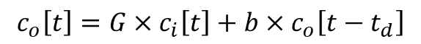
Pitch filtering of CELP [M. Schroeder+, 1984]
CELP
Pitch filtering (long-term correlations)
Spectral filtering (short-term correlations)
Pitch filtering
Model current sample with innovation input and related previous samples:
$$c_{o}\left[t\right]=G×c_{i}\left[t\right]+b×c_{o}\left[t−t_{d}\right]$$
Notes:
Td: time delay related to pitch

Slide 19
Pitch-dependent dilated convolution
Fixed number of samples in a receptive filed
Determined by the number of network layers
Effective receptive field can be changed with different dilation size
Pitch-dependent
Dilated convolution:
Dilation size d
Vanilla DCNN: time-invariant and constant
Proposed PDCNN: time-variant and pitch-dependent
Notes:
As we know, the number of samples in a receptive field is determined by the network size.
However, the effective receptive field can be changed by different dilation size.
Specifically, dilated convolution can be formulate like that.
The current output Xt(o) can be a weighted sum of the current input and a past sample with dilation size d.
For vanilla dilated CNN the dilation size is a time-invariant constant.
But our proposed pitch-dependent CNN has a time-variant dilation size.

Slide 20
Pitch-dependent dilated convolution (cont.)
Pitch-dependent dilated factor: E_{t} = F_{s}/(F_{0,t} × a)
Notes:
We introduce a pitch-dependent dilated factor Et to control the dilation size to dynamically extend the effective receptive field.
The dilated factor Et is the sampling rate divided by each sample’s pitch and a dense factor.

Slide 21
Dense factor
Dense factor a is the number of samples in one cycle period taken into account
Notes:
Dense factor indicate the number of samples in one cycle period taken into account.
For example, the first we take 8 samples in one cycle, and the last figure we only take 2 samples ion one cycle.

Slide 22
Effective receptive filed
Fixed number of samples in a receptive filed
Fixed number of samples in one cycle
The same number of past cycles in a effective receptive field for arbitrary F₀
Notes:
Here is an example to explain the concept of effective receptive filed with dense factor.
According to the two figures, we find that although the signals have different frequencies, the same dense factor makes the effective receptive fields include the same number of past cycles.

Slide 23
Cascaded networks
Fixed modules for short-term correlations
Fixed dilated convolution (DCNN)
Adaptive modules for long-term correlations
Pitch-dependent dilated convolution (PDCNN)
Notes:
Furthermore, we propose a cascaded structure of the fixed and adaptive modules to simultaneously model the short- and long-term correlations of speech signals.

Slide 24
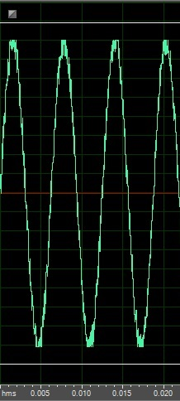
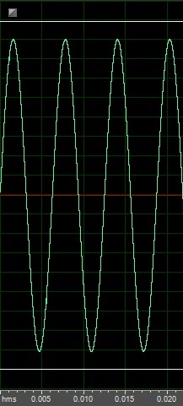
Sine wave generation
To evaluate the effectiveness of PDCNN for periodicity modeling
Sine wave generation
Input: Noisy sine wave (SNR:20dB)
and 1-dim noisy F₀
Output: Clean sine wave
Training
4000 single-tone sine wave (1 sec / utts)
Testing
Initialize the receptive field with
the noisy single-tone sine wave
Noisy 1-dim F₀ as the auxiliary (conditional) feature (1 sec)
Input
Output

Slide 25
Experiments setting
Training
80~400 Hz sine waves (step size: 20Hz)
Testing
Under 1/2 L: 10–40 Hz (step size: 10Hz)
Above 1/2 L: 50–70 Hz (step size: 10Hz)
Inside: 80, 90, 100, 200, 300, 400 Hz
Under 3/2 U: 450–600 Hz (step size: 50 Hz)
Above 3/2 U: 650–800 Hz (step size: 50 Hz)

Slide 26
Experiments setting
Objective measurement
SNR
RMSE of log F₀
Models
pQPNet: all adaptive modules
QPNet: fixed-adaptive modules
rQPNet: adaptive-fixed modules
WNf: full-size WaveNet
WNc: compact-size WaveNet

Slide 27
Model comparison
Hyper-parameter | WNf | WNc | (r)QPNet | pQPNet
Number of fixed layer | 10 | 4 | 4 | -
Number of fixed repeat | 3 | 4 | 3 | -
Number of adaptive layer | - | - | 4 | 4
Number of adaptive repeat | - | - | 1 | 4
Constant a | - | - | 8
Causal and dilated CNN | 128 channels
1×1 CNN in residual block | 128 channels
1×1 CNN between skip-connection and softmax | 64 channels
Number of parameters (×10⁶) | 2.8 | 15 | 15 | 15

Slide 28
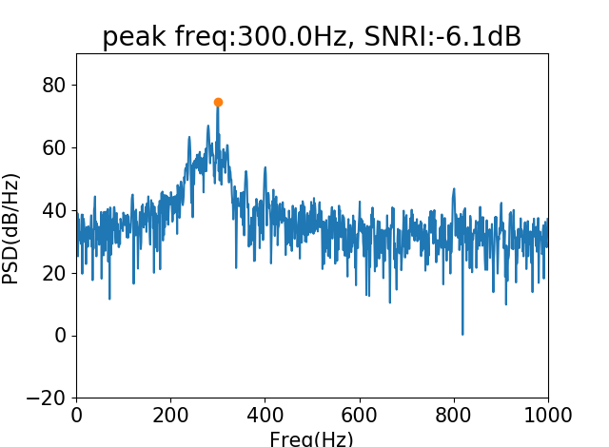
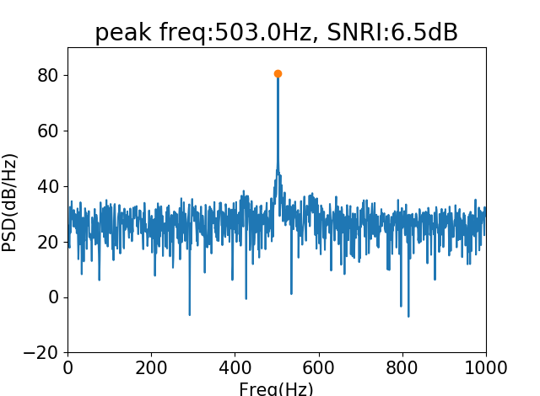
Peak frequency extraction
Power spectrum density
Auxiliary feature: 500Hz (unseen)
WNf
pQPNet

Slide 29
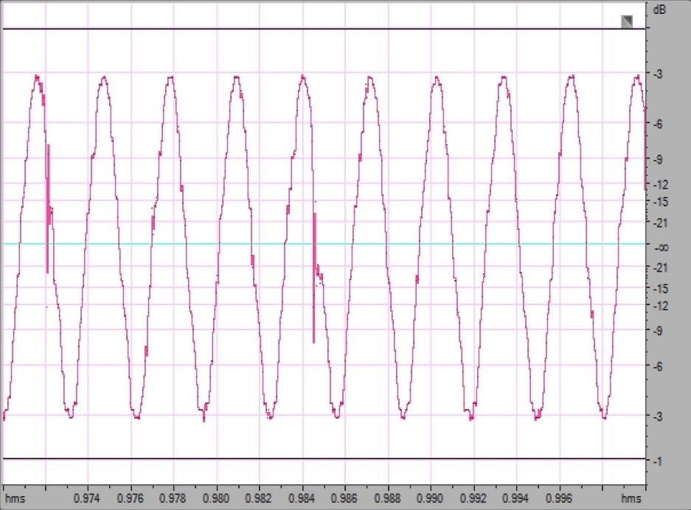
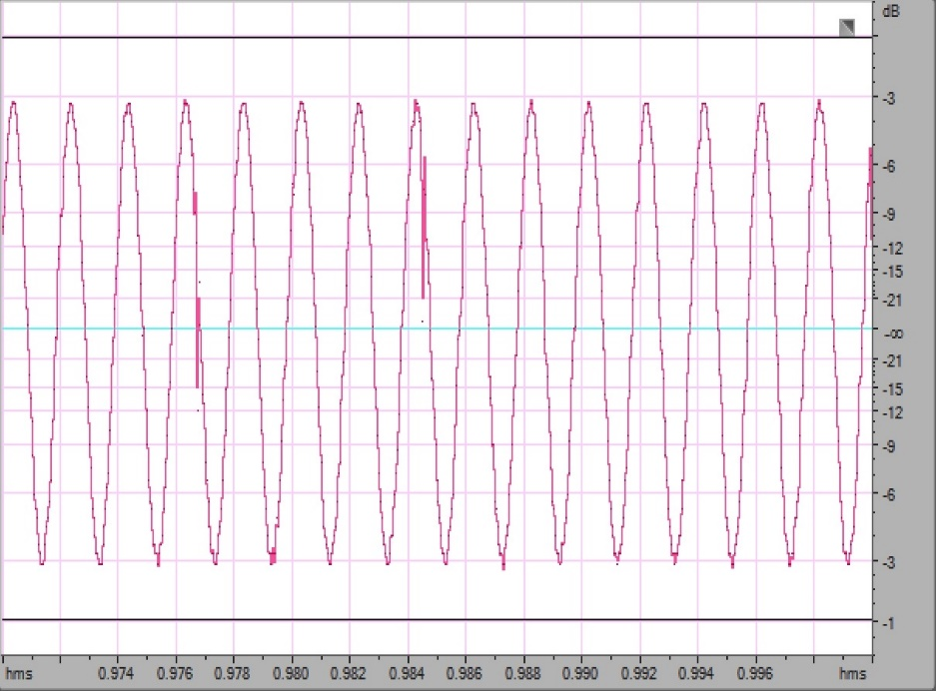
Output single-tone sine wave
Auxiliary feature: 500Hz (unseen)
WNf
pQPNet

Slide 30
Dense factor comparison
pQPNet with dense factor 1, 2, 4, 8, 16, 32, 64
Dense factor 1 and 2 are unstable
Dense factor 32 and 64 easily degenerate PDCNN into DCNN in the high F₀ cases
We set dense factor 8 for the balance of speech quality and pitch-accuracy

Slide 31
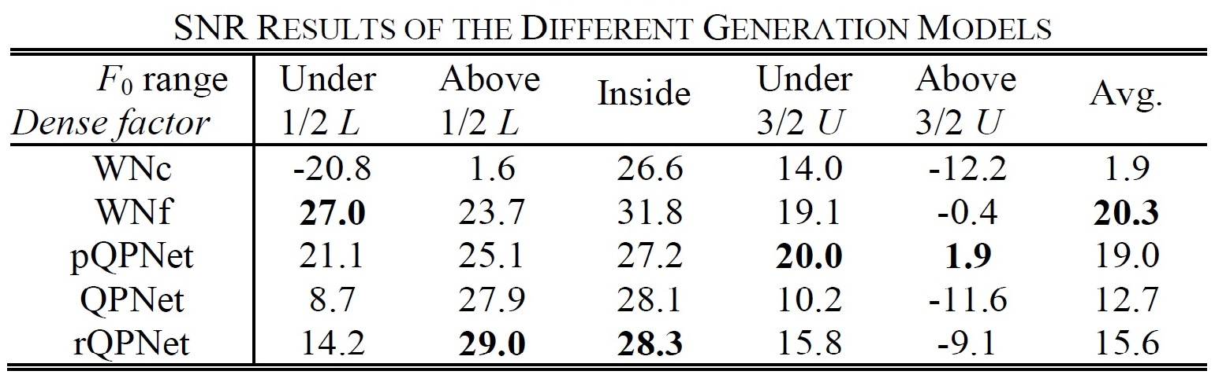
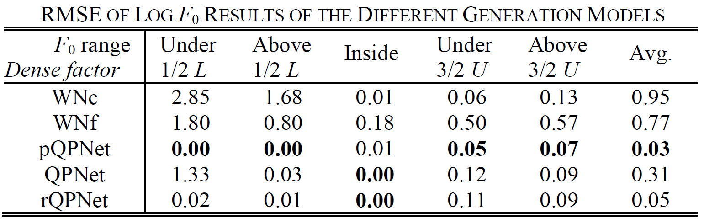
Model comparison
PDCNN significantly improve the capability of periodicity modeling

Slide 32
Experiments setting
Corpus for WaveNet-based vocoder
VCC2018 and patrial CMU ARCTIC
Training (VCC2018): 81 sentences * 12 speakers
Training (ARCTIC): 1034 utterances * 2 speakers
Testing (SPOKE set): 35 utterances / speaker
Models
QPNet / rQPNet with cont./ disc. E_{t}
WNf / WNc
Full QPNet/ rQPNet (WNf with 4 etra adaptive layers)
WORLD

Slide 33
Model comparison
Hyper-parameter | WNf | WNc | QPNet | Full QPNet
Number of fixed layer | 10 | 4 | 4 | 10
Number of fixed repeat | 3 | 4 | 3 | 3
Number of adaptive layer | - | - | 4 | 4
Number of adaptive repeat | - | - | 1 | 1
Constant a | - | - | 8
Causal and dilated CNN | 512 channels
1×1 CNN in residual block | 512 channels
1×1 CNN between skip-connection and softmax | 256 channels
Number of parameters (×10⁶) | 44 | 24 | 24 | 50

Slide 34
Experiments setting
Sampling rate: 22.05kHz
Acoustic features (extracted using WORLD)
34-dim mel-cepstral coefficients (mcep)
2-dim coded aperiodic features
1-dim interpolated continuous F0
1-dim voice/unvoice binary flag
Scaled F₀
Ratio: unchanged, 1/2, 3/4, 5/4, 3/2, 2
MCD, RMSE of log F₀, U/V detection error

Slide 35
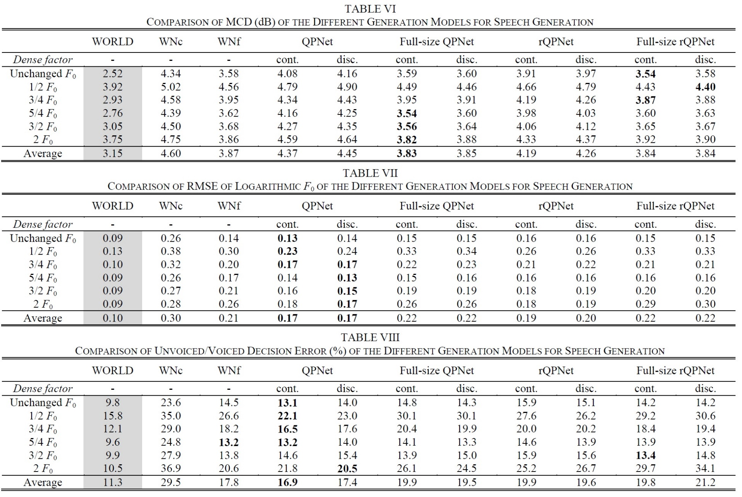
Objective evaluation

Slide 36
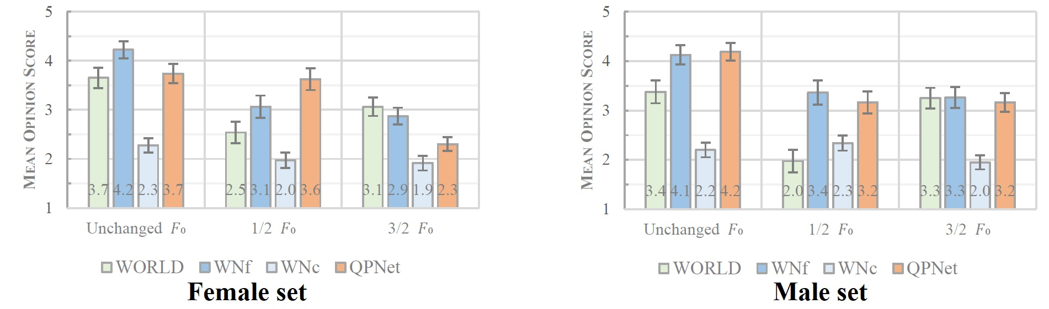
Subjective evaluation
MOS for speech quality

Slide 37
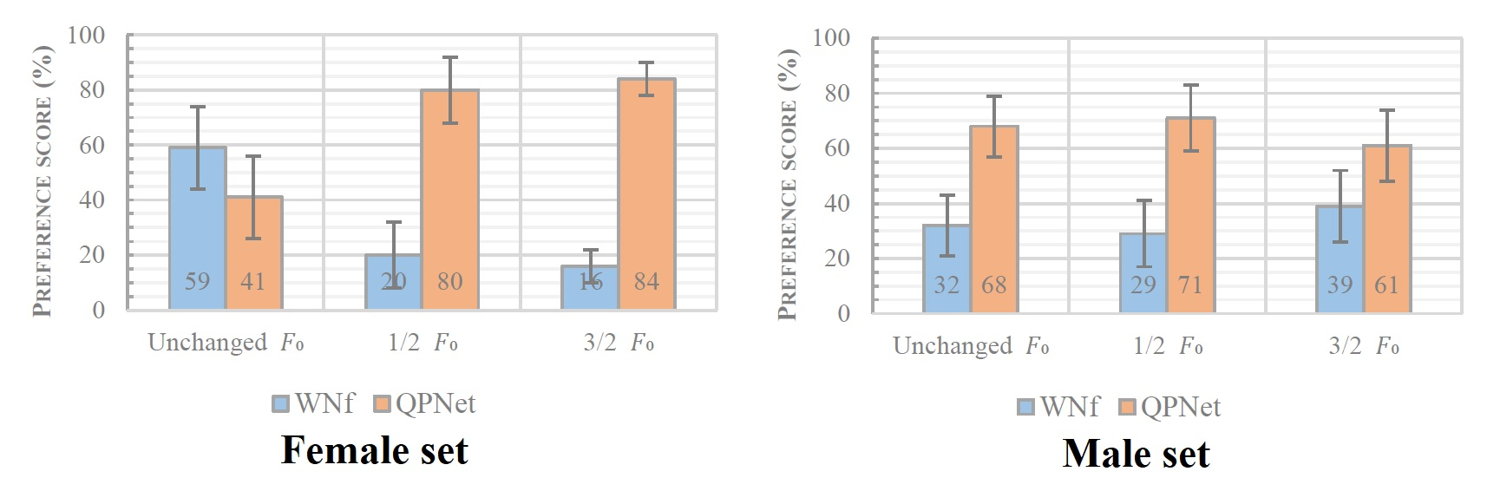
Subjective evaluation
XAB preference test for pitch accuracy

Slide 38
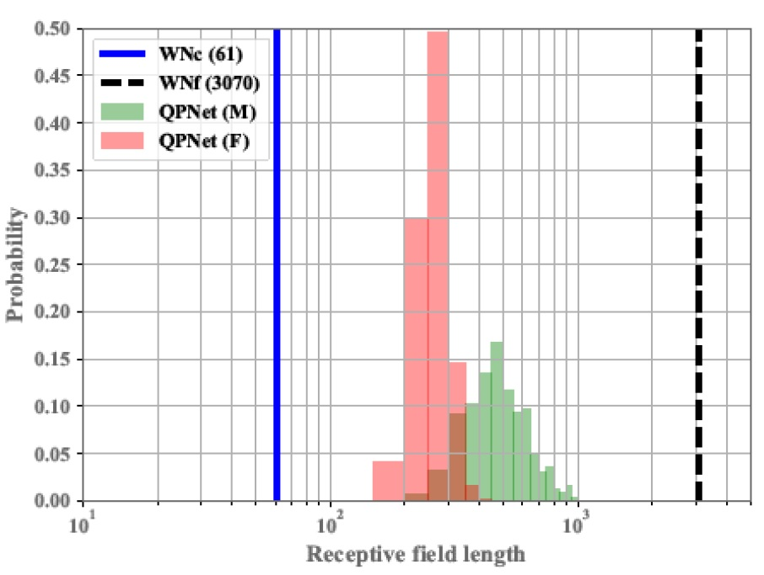
Effective receptive field length
WNf > QPNet(male set) > QPNet(female set) > WNc

Slide 39
Demo
Condition on unchanged F₀
 | Female | Male
Natural
WORLD
WNf
WNc
QPNet
rQPNet
Full QPNet
Full rQPNet

Slide 40
Demo
Condition on 1/2 F₀
 | Female | Male
Natural | - | -
WORLD
WNf
WNc
QPNet
rQPNet
Full QPNet
Full rQPNet

Slide 41
Demo
Condition on 3/2 F₀
 | Female | Male
Natural | - | -
WORLD
WNf
WNc
QPNet
rQPNet
Full QPNet
Full rQPNet

Slide 42
Conclusion
PDCNN efficiently extends the effective receptive filed and reduces the network size requirement.
Cascaded structure simultaneously models long- and short-term correlation well.
Pitch controllability
QPNet significantly outperforms WNf and WNc
Speech quality
QPNet outperforms same-sized WN (WNc)
QPNet is comparable with double-sized WN (WNf)

Slide 43
Thank you for your attention ! https://bigpon.github.io/QuasiPeriodicWaveNet_demo/

